Slide 1
Open Access Publishing
in Cambridge journals
Updated 16/01/2020

Slide 2
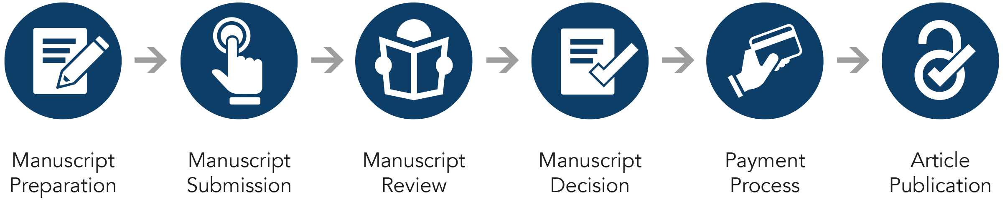
Open Access Publishing Workflow
Open Access Publishing Workflow

Slide 3
Submission Systems – OPRS (Online Peer Review System)
Open Access Publishing Workflow
Notes:
Of the 398 within the Full Package: 61% are on ScholarOne (242 journals), 11% on Editorial Manager (46 journals), 5% on other platforms (20 journals), and a further 23% not on an OPRS system (90 journals).
The full list of which journals are on which systems can be shared upon request.

Slide 4
Cambridge Publishing Output
19,004 Research Articles
8.3% OA Articles

Slide 5
Manuscript preparation
Open Access Publishing Workflow
Author:
Discovers journal
Visits journal information page
Reviews author instructions
Formats manuscript

Slide 6
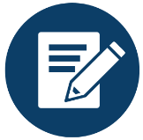
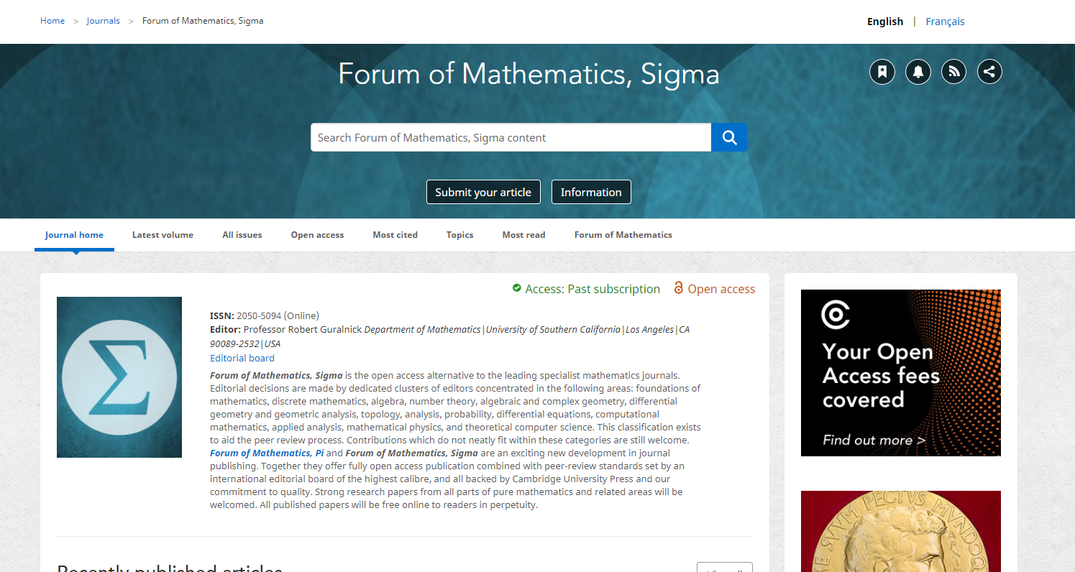

Manuscript preparation
Open Access Publishing Workflow
Information on manuscript preparation is available on Cambridge Core, via the journal landing page. This page will include detail on open access publishing options available in that journal.
Whenever possible, we invite and remind authors to check their eligibility for APC waivers and discounts (e.g. banners).
Notes:
Author discovers journal
Information on manuscript preparation and processes is available on Cambridge Core, via the journal landing page. This page will include detail on open access publishing options available.
Whenever possible, we invite and remind authors to check their eligibility for APC waivers and discounts, e.g. banners on full OA journal homepages link to: www.cambridge.org/check-your-oa-eligibility
different wording to suit the community and needs of the journals (e.g. whether or not APCs are charged etc).

Slide 7

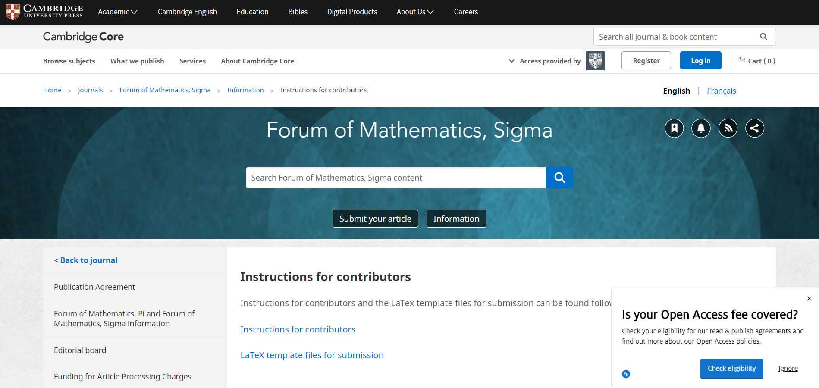
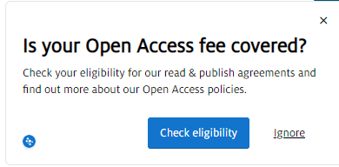
Manuscript preparation
Open Access Publishing Workflow
Detailed information for contributors is available here.
Pop ups appear on relevant gold OA and hybrid journal information pages to invite authors to check their eligibility for an APC waiver / discount.
Notes:
Author reviews information for contributors
Detailed information for contributors is available here.
Pop ups appear on all relevant gold OA and hybrid journals IFCs (and any OA page they may have) inviting authors to check their eligibility.
Links to: www.cambridge.org/check-your-oa-eligibility

Slide 8
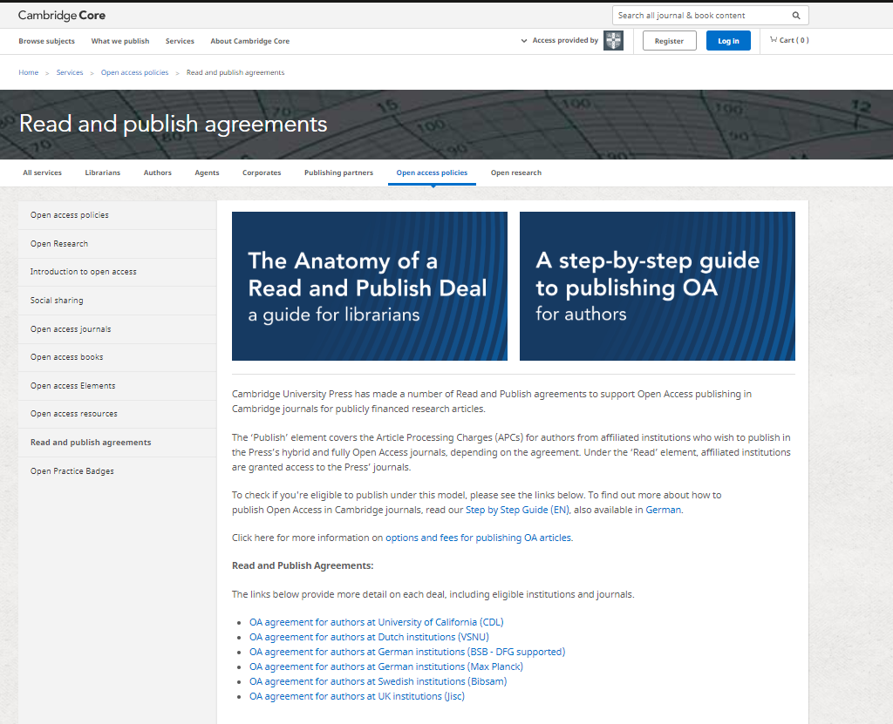
Manuscript preparation
Open Access Publishing Workflow
Link clicks through to read and publish agreements page
Details of read and publish agreements are hosted on Cambridge Core.
Authors may consult this page for more information on the specific terms agreed between Cambridge and their institution.

Slide 9
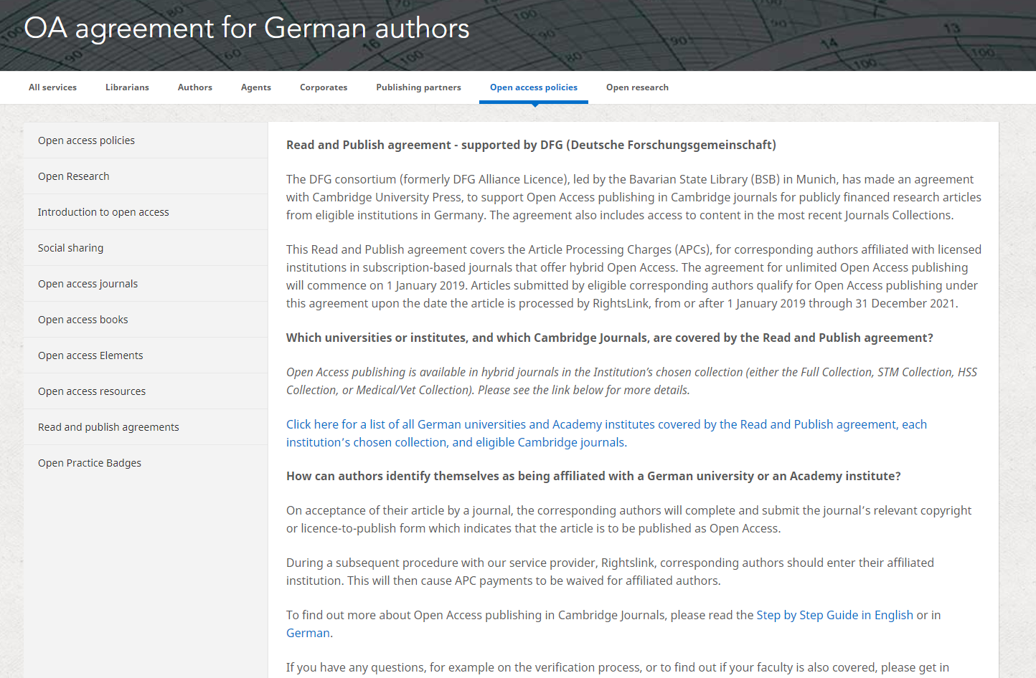
Open Access Publishing Workflow
Link to participating institutions and eligible journals
Link to ‘Step by Step Guide’ to publishing OA in Cambridge journals

Slide 10
Manuscript submission and review
Open Access Publishing Workflow
Author:
Navigates to submission system from journal homepage
Logs into submission system
Submits manuscript and supplementary materials
Checks status in online submission system

Slide 11
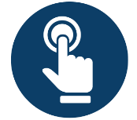
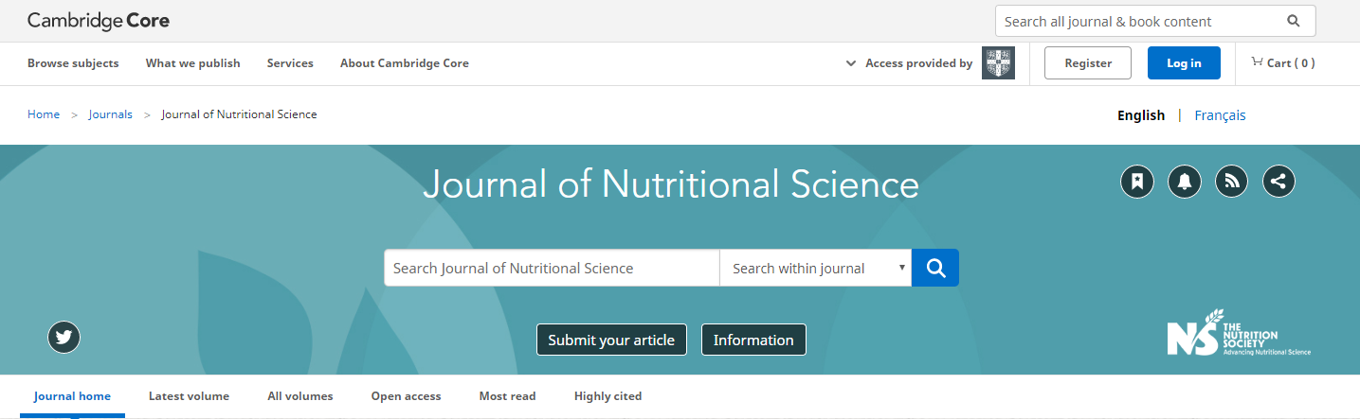
Manuscript submission
Open Access Publishing Workflow
Authors navigates to the submission system from the journal’s homepage on Cambridge Core
Notes:
Author logs into submission system
Authors navigate to the submission system from the journal’s homepage on Cambridge Core

Slide 12
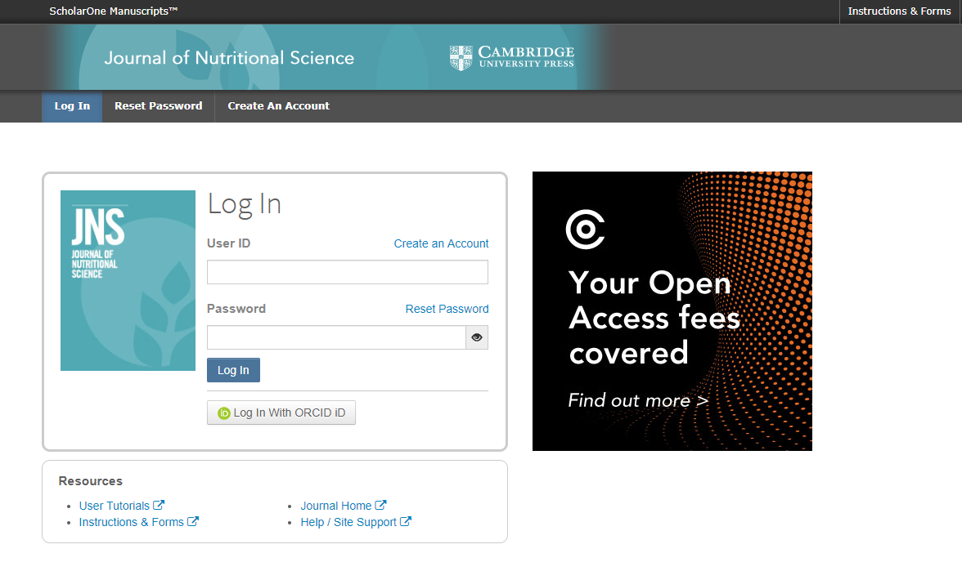
Manuscript submission
Open Access Publishing Workflow
To submit their manuscript, authors must log in, using either a username and password or their ORCID iD.
Notes:
Author logs into submission system
For our journals on ScholarOne, banners direct authors to find out more about publishing OA
For those not on an online submission system, manuscripts will be reviewed by the editorial office / team.

Slide 13
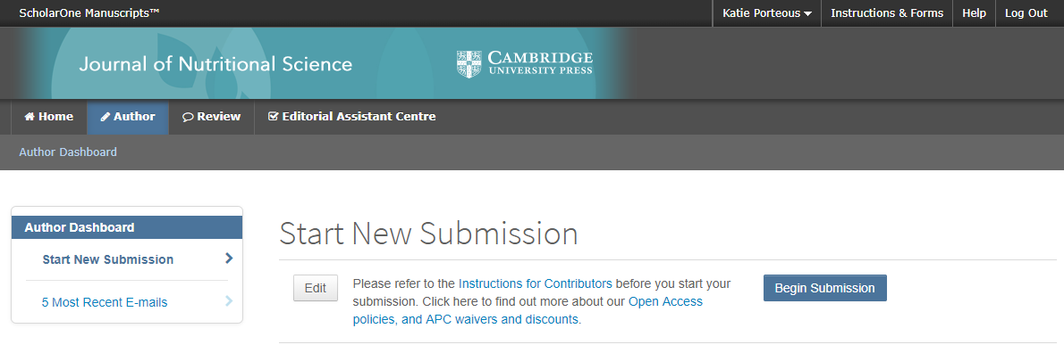
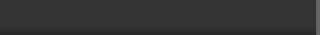

Manuscript submission
Open Access Publishing Process
Notes:
Author logs into submission system
Directions to OA policies on Author Dashboard in submission system.

Slide 14
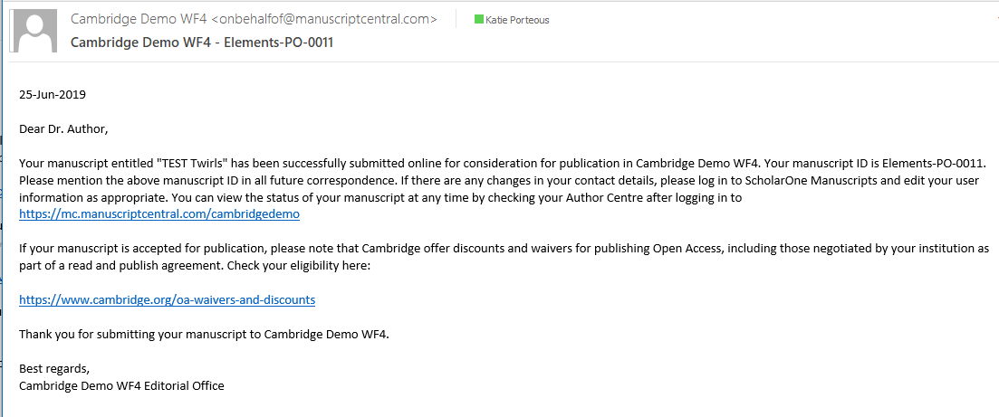
Manuscript submission confirmation email
Open Access Publishing Workflow
Following submission, the author’s manuscript enters the peer review process.
The author is not required to indicate if they wish to publish OA at this point.
Notes:
Confirmation of submission
From this point, the manuscript will go into peer review

Slide 15

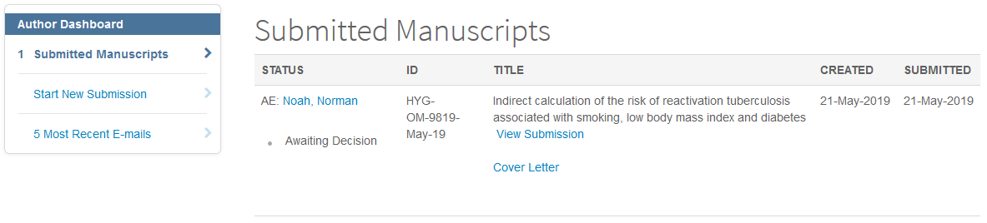
Manuscript review
Open Access Publishing Workflow
Author Centre – check status
Using the author dashboard, it is possible to check the status of submissions. The status may differ depending on the journal, but most will say ‘under review’ or ‘awaiting decision’.
Notes:
Author Centre
Authors can view the status of their manuscript.
Generally the status will say “under review” or “awaiting decision”, some will include more detail (depending on the journal’s workflow)

Slide 16
Manuscript decision
Open Access Publishing Workflow
Author:
Receives acceptance email
Resubmits article with revisions
Completes copyright transfer form
Chooses licence
Deposits accepted manuscript

Slide 17
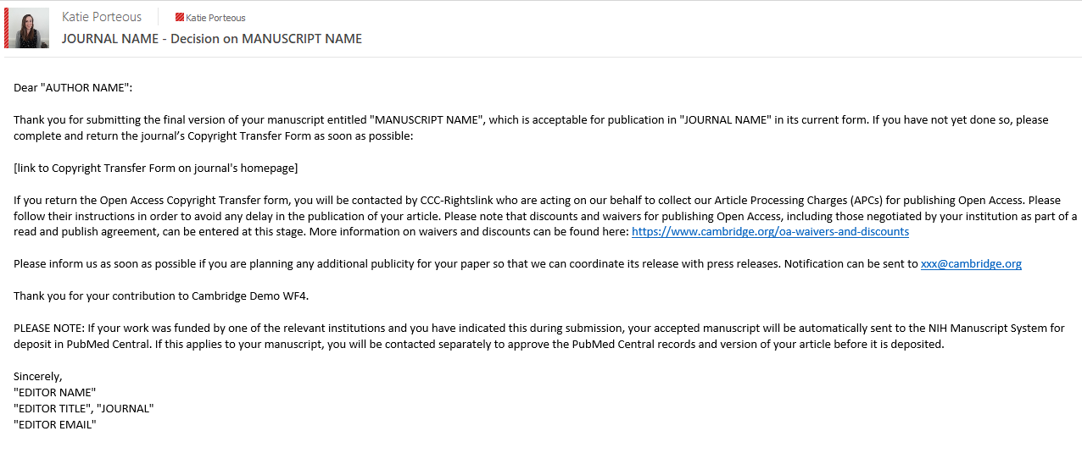

Manuscript decision email
Open Access Publishing Workflow
If an article is accepted, following the completion of any revisions required, authors will receive an acceptance email.
Completing the OA copyright transfer form is how an author decides to publish an article OA.*
Once an article is accepted, a record will be created Cambridge’s production tracking system, including the article and copyright transfer form.
*When publishing Gold OA, authors are offered a choice of Creative Commons licences.
Notes:
Acceptance email
Sent from Online Peer Review System, includes link to copyright transfer form. Filling out the OA copyright transfer form is the key step in making an article OA.
Once an article is accepted, a record will be created in our production tracking system, including the copy and the copyright transfer form.

Slide 18
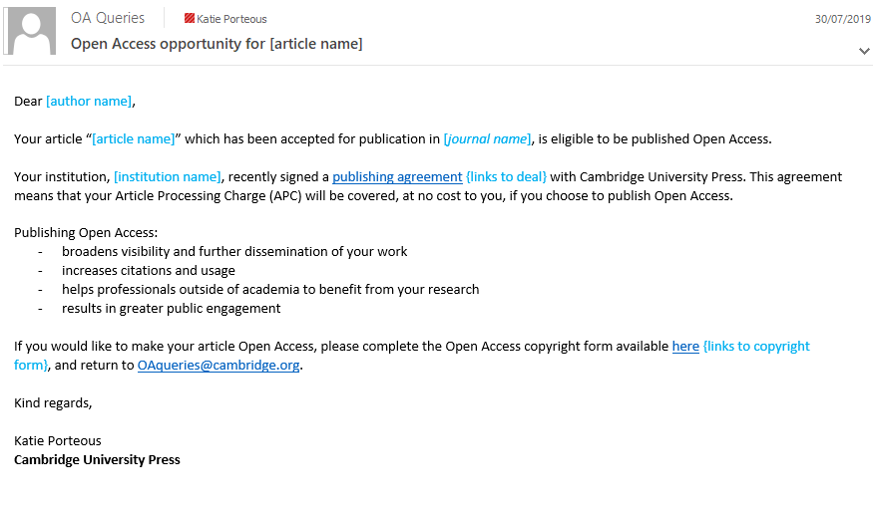
Custom email – Open Access opportunity
Open Access Publishing Workflow
We have the ability to identify eligible authors who have not selected to publish open access and communicate this opportunity to them before their article is published.
If the read and publish agreement contains a ‘retroactive OA’ element, the same can be done for articles that have been published.
Notes:
Custom email
To authors who have select non-OA, but are eligible to publish OA – before and after publication
Data is collected from the ‘copy received date’ in our production tracking system

Slide 19
Agreement Manager - Transaction process
Open Access Publishing Workflow
What is Agreement Manager?
Author workflow – what will change?
Agreement Manager profile overview – publisher portal
Agreement Manager – institutional portal

Slide 20
Open Access publishing workflow
Cambridge OA Journals Workflow - Rightslink Demo
Notes:
Articles are only sent to RL if the author has selected a gold open access CC license when signing their copyright transfer form/license to publish
- The copyright transfer form is requested once an article has been accepted for publication

Slide 21
What is “OA Agreement Manager”?
Cambridge OA Journals Workflow - Rightslink Demo
Cambridge has recently entered into an agreement with Rightslink CCC to use their new tool, OA Agreement Manager, which has been purpose-built to facilitate smoother financial transactions in Read and Publish deals.
The system offers a number of advantages:
Actively identifies authors who are eligible for an APC discount/waiver and provides touch free transaction for author
Allows institutions to authorise APC funding requests
Gives institutions visibility on APCs processed under their agreement
Allows publishers to configure the parameters of their own agreements
Notes:
Agreement Manager is a web portal that:
Allows publisher to configure the parameters of their own open access agreements in the RL portal
Actively identifies authors who are eligible for an APC discount under an open access agreement
Allows institutions to review ‘funding requests’ under open access agreements
Gives institution visibility on APC discounts processed under their deal by tracking spend and transaction reports

Slide 22
Author workflow - What will change?
Agreement Manager transaction process for authors

Slide 23
Production Process
Once an article is accepted for publication the author/s are required to complete a Copyright Transfer Form/License to Publish
If an author has chosen a Gold Open Access license, the Production Editor will assign a Grid ID to the article based on the institution of the corresponding author
The Production Editor sends the article to Rightslink to create a transaction for the APC. Included in this information is the Grid ID, corresponding author email address and journal of publication
Rightslinks uses this information to match the article with the parameters of a publishing agreement and automatically apply the appropriate discount to the APC

Slide 24
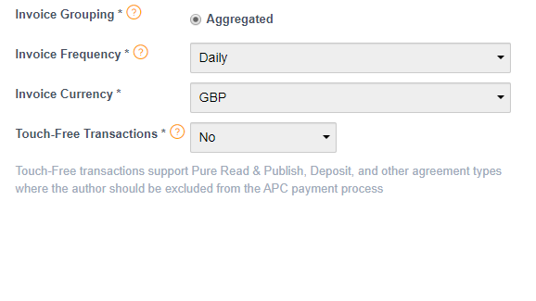
Touch Free Transactions
An institution with a 100% unlimited Read and Publish deal can opt for their authors to by-pass the transaction workflow. This means that the authors will not need to interact with Rightslink at all.
The transaction details will be sent from production, match with a profile and complete the transaction automatically.
A final notification will still be sent to the author to confirm the APC discount has been approved
This can work in conjunction with the funding request approval function in the Institutional Portal. Institutions can also still receive notifications.
This configuration must be decided upon before the profile can be created and is not editable once the profile is active or throughout the agreement.

Slide 25
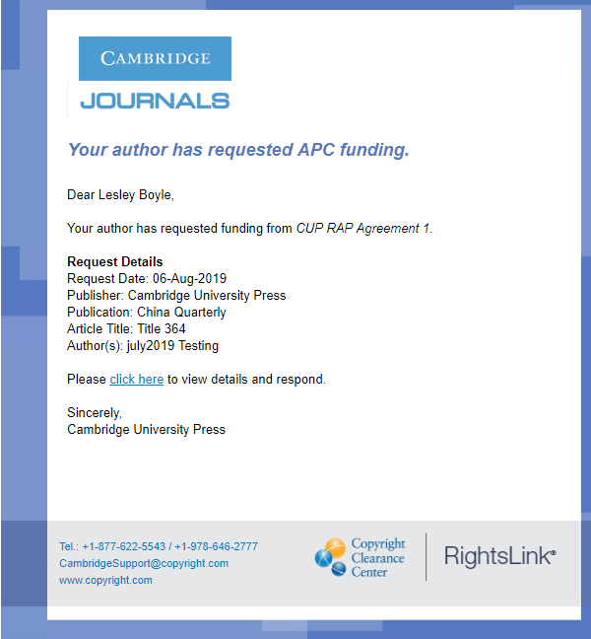
Cambridge OA Journals Workflow - Rightslink Demo
Institution receives notification of the funding request
Notes:
The link in the institution’s email notification leads directly to the institutional portal

Slide 26
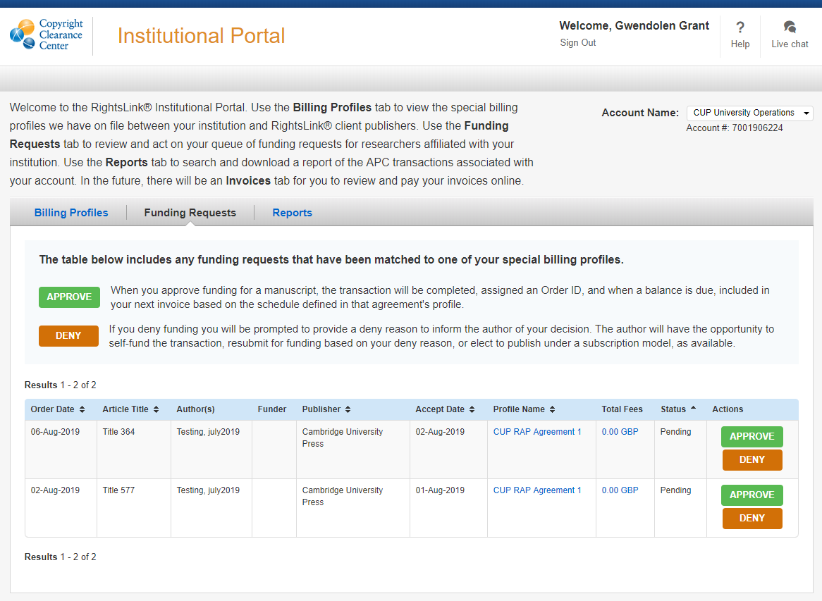
Institutional portal
Cambridge OA Journals Workflow - Rightslink Demo
Librarian view of all articles submitted from researchers in their institution requiring OA funding approval
Librarian approves or denies request
Notes:
Hovering over the author of an article will show the criteria used to match the article to the profile – Grid ID or email domain
Clicking on the Total fee of an article will show the author confirmation screen with article details
Clicking on the profile name will show the details of the profile
If a request is approved, a confirmation email is sent straight to the author
If a request is denied – see next slide

Slide 27
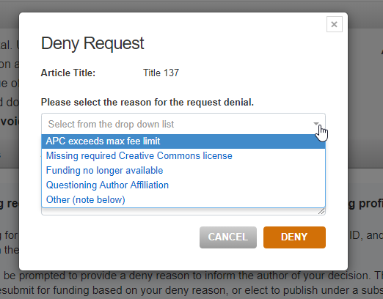
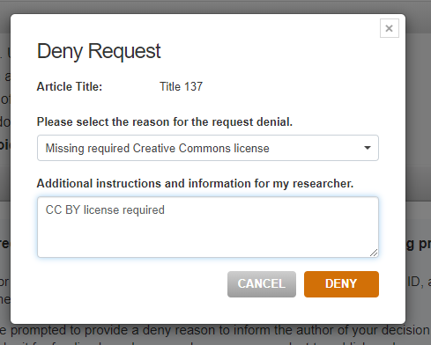
Institutional portal
Cambridge OA Journals Workflow - Rightslink Demo

Slide 28
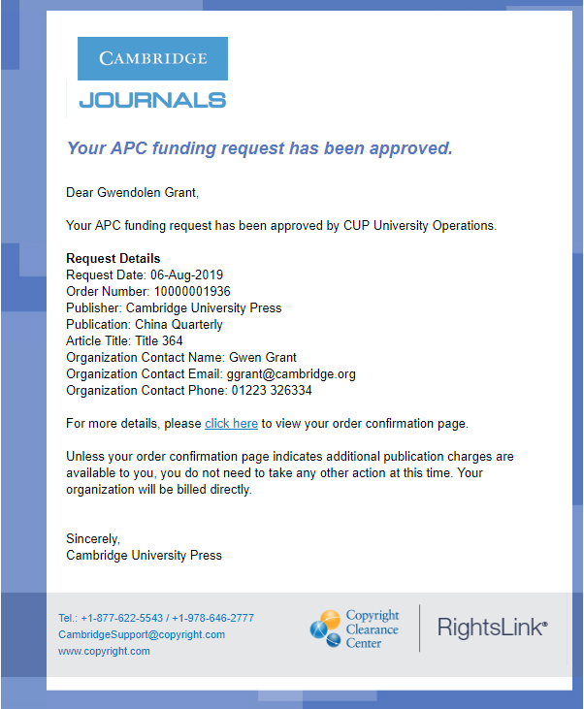
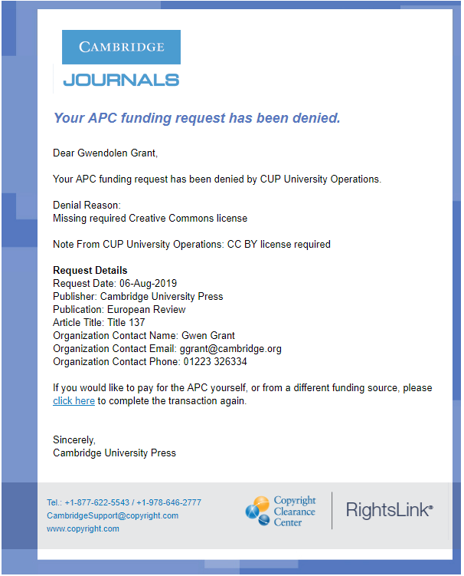
Cambridge OA Journals Workflow - Rightslink Demo
Confirmation email to author that request has been approved or denied
Notes:
Takes the author back into the transaction workflow
They receive the pop up message matching them to a profile so there needs to be some text to ask them to choose ‘bill me’

Slide 29
Agreement Manager Profile Overview
Publisher Portal
Notes:
CUP is now able to create a profile within RL Agreement Manager based on the criteria of a read and publish deal
This includes the ability to match articles we send to RL for APC payments to be matched to a profile base on the institution of the corresponding author, meaning that the relevant APC discount can be automatically applied to the article

Slide 30
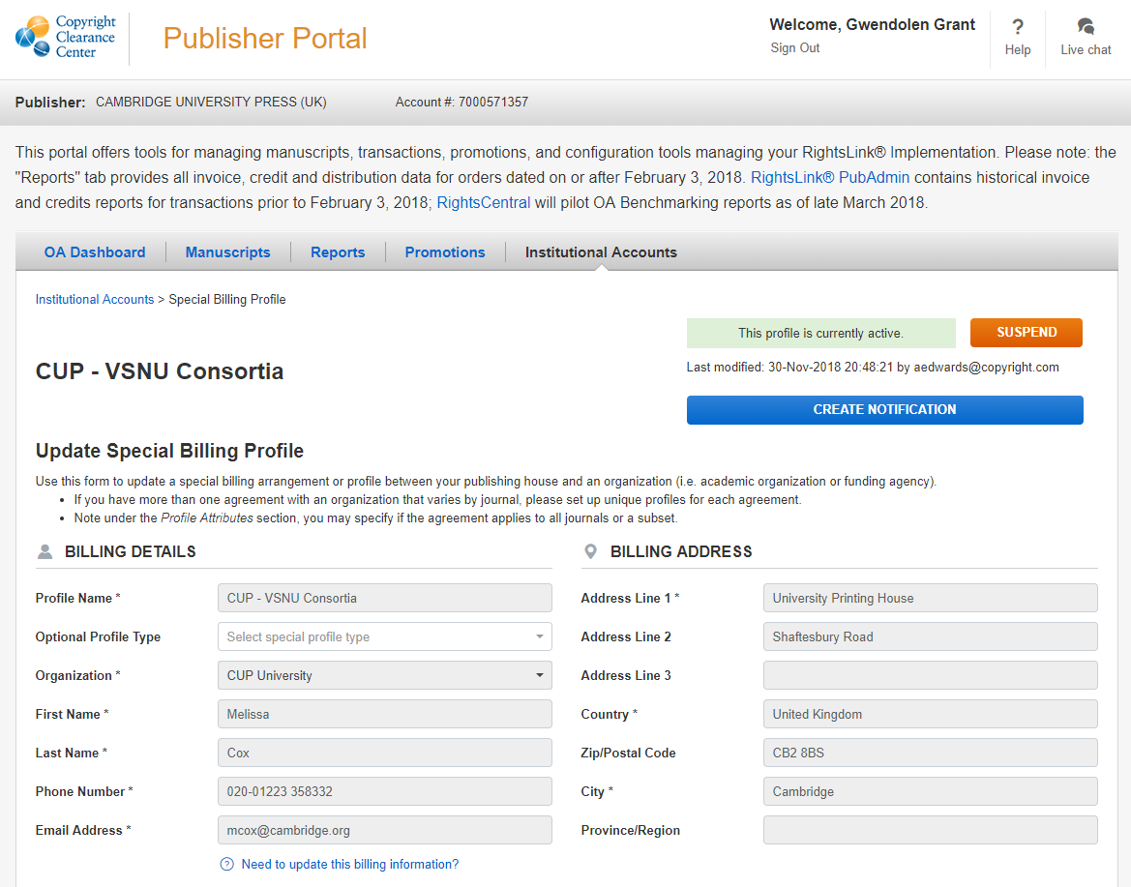
Billing details
Profile can be suspended or re-instated at any time
Notifications on token or deposit usage can be created here
Billing details of either consortium or institution form the basis of the profile
Notes:
Billing details
Can either be a consortia level or institution level
Forms the basis of the profile and the institutional portal – profiles for different institutions can be linked by an overarching billing organisation
Details need to be set up in RightsLink financial systems before a profile can be made
These details are required even if the organisation does not expect to receive any billing as their APCs are 100% waived

Slide 31
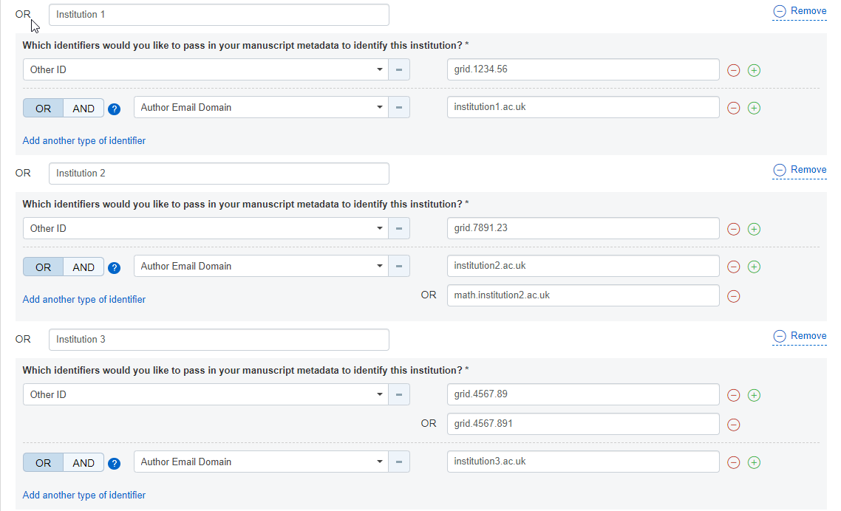
Institution matching criteria
Articles are matched with a profile and offered the appropriate discount for their APC based on Grid ID and/or email domain.
These identifiers can be added, updated or removed throughout the agreement.
Notes:
We are currently using Grid and email domain to match articles to profiles
Production editors add a Grid ID based on the corresponding author institution to the article details before sending article data to RL
There is a limit of 50 identifiers per profile – if more are required, another profile can be created
Multiple identifiers can be added for a single institution

Slide 32
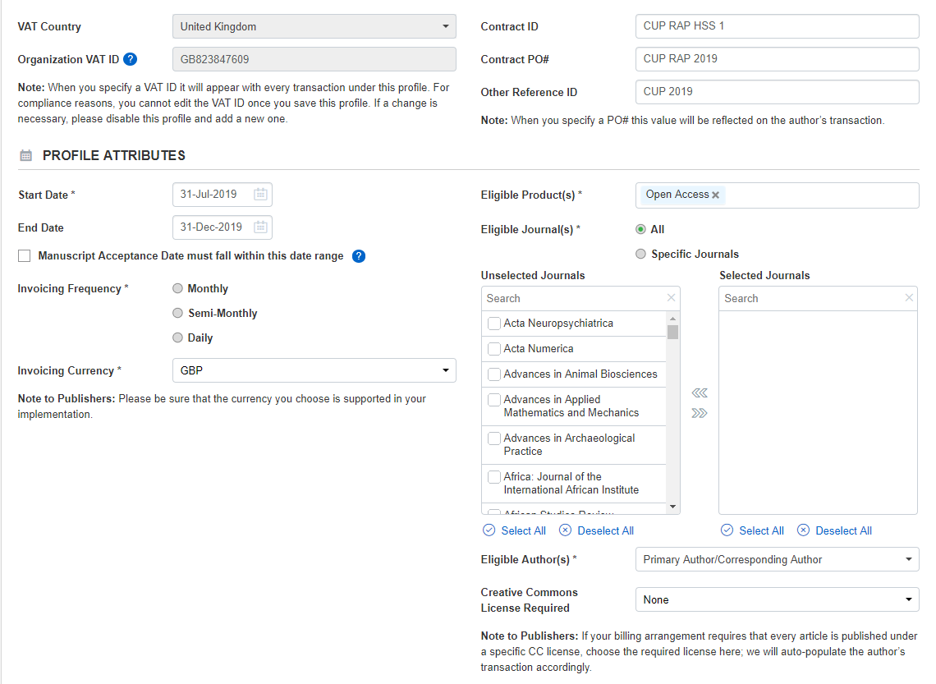
Agreement criteria
Contract PO – Institution’s PO number, will appear on author confirmation screen and invoicing if applicable
End Date – profile will automatically expire after this date
Invoicing currency – will show the APC price in a single currency
Eligible journals – only articles from chosen journals will match with the profile
Notes:
Contract PO is optional
Other ID references are for internal use
‘Manuscript Acceptance Date must fall within this date range’ – CUP are not currently sending this information to RL so this cannot be used
Eligible authors – CUP only sends the details of one author to RL so this does not effect article matching
Creative Commons License Required – CUP sends CC license type to RL but the functionality to use this as a profile matching criteria is not there

Slide 33
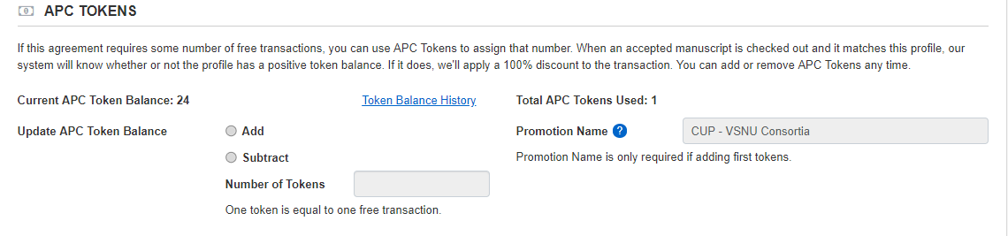
APC tokens and discounts
Read and Publish discount
Agreement Manager discounts are driven by tokens
Tokens can be added or subtracted at any time throughout the agreement
Promotion Name will appear on reporting
Notes:
The mechanics of the automated discounts are driven by a background token system
For unlimited 100% deals we can add as many tokens as we like and keep topping them up
Notifications can be set up to warn us when the tokens fall below a certain threshold and need to be topped up
Once the tokens reach 0, the profile will no longer match with articles to offer OA under the agreement
Value thresholds will be available from the October 2019 release
The value can be amended throughout the agreement if an institution wishes to pay more APCs
Agreement Manager can currently only offer 100% discounts on APCs (1 token = 1 article regardless of APC price). Customisable % discounts will be available in the December 2019 release.

Slide 34
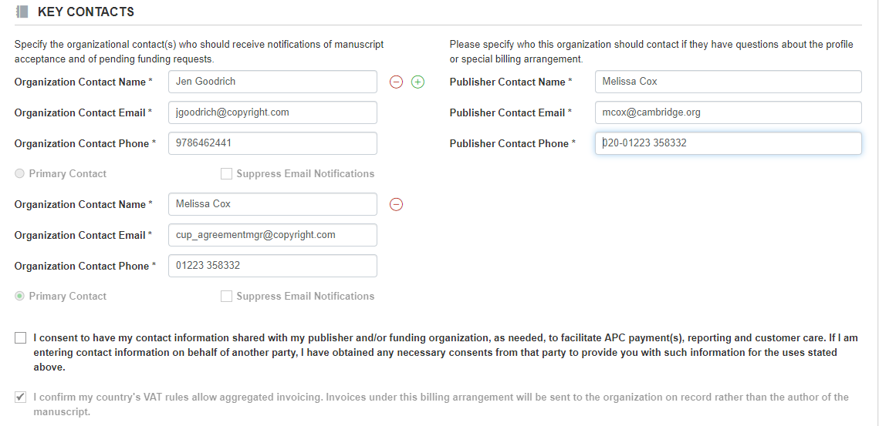
Key contacts
Organization Contacts will be able to log into the Institutional portal and approve or deny articles requesting to use the agreement discount
Publisher contact will appear in the institutional portal
Notes:
Up to 3 organization contacts can be added
1 can be selected as a primary contact
Email notifications can be suppressed for each individual contact
Consent tick box – we will need to gain explicit consent from the organization to confirm this – store in SF?

Slide 35
Agreement Manager Institutional Portal
Notes:
Example of RightsLink Transaction Summary Report attached along with a separate document with notes on what the fields tell us – fields currently used for reporting are highlighted in yellow, fields with potentially confusing data highlighted in red
Institutions have access to the same transaction report as CUP from the institutional portal

Slide 36
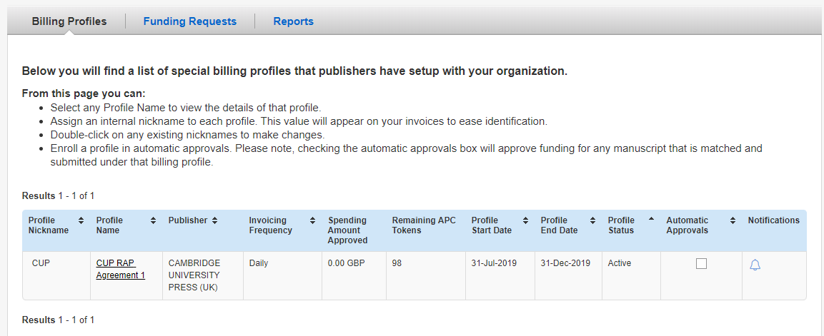
Billing Profiles
Notes:
Billing profiles will show all profiles associated with the billing details provided for profile set up from CUP as well as any other publishers using agreement manager
Automatic approvals check box – checking this box will bypass the need for institutions to verify funding requests, all articles will be automatically approved
Notifications can be set up for token and deposit usage

Slide 37
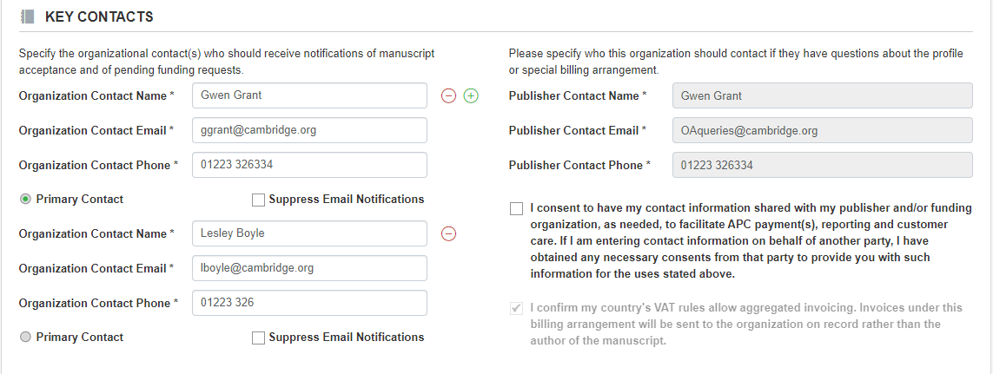
Key Contacts
Notes:
Institutions can see the criteria the publisher has used to set up a profile – the view is the same as the publisher portal view previously shown except for a couple of features:
Organisation contact details – initially entered by the publisher but can be updated by the institution at any time
A check box next to each contact can suppress email notifications – this can be switched on and off at any time

Slide 38
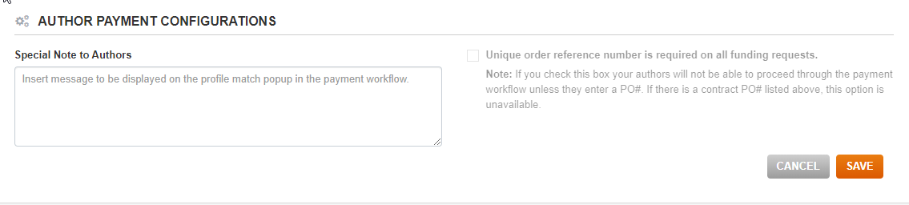
Institution Message to Authors
The Special Note to Authors will appear in the initial pop up message once an author has begun an APC transaction matched to an Agreement Manager profile.
This can be updated throughout the agreement period.

Slide 39
Summary of key CUP workflow projects

Slide 40
Improving the Cambridge OA publishing workflow
Open Access Publishing Workflow
Seven technology projects
Example projects
A series of key technology projects in one programme, running over this fiscal year to ensure:
We develop the best workflow for our authors and customers
All our article and author metadata is present and correct to fully support read and publish deals
Our existing systems have the necessary support, and plans for new systems are developed around the needs of our customers.
OA & Author Data
Improved storage of author and article metadata
Content Enrichment
Additional metadata in backlist content
Terms of publication
Digital solution for the completion, collection & storage of copyright forms
Notes:
A series of key technology projects are running over this fiscal, under the ‘Operationalizing Open Access’ programme.

Slide 41
Cambridge OA Journals Workflow - Rightslink Demo
CUP – Operationalising Open Access Programme Update
Completed/ Due to Deliver
Clear messaging throughout author journey, signposting R&P eligibility
Roll out of bespoke messaging to authors with details of specific deals
Launch of dedicated customer support function
Capture of full metadata at submission point, capturing GRID as the key institutional identifier
Revision of all “Copyright Transfer” forms for OA – to be replaced by “Author Publishing Agreement”
Forthcoming
Digital licence management tool
R&P Eligibility checking tool for authors
Continued improvements to communications during submissions process to drive “default OA”

